Slide 1
ROBODK
PDE4424 Industrial Manipulators
Judhi Prasetyo & Bittu Scaria
Middlesex University Dubai

Slide 2
RoboDK
RoboDK is software for Simulation and Offline Programming. Offline Programming means that robot programs can be created, simulated and generated offline for a specific robot arm and robot controller. RoboDK can help you with manufacturing operations involving industrial robots.
Download and install RoboDK from the website: https://robodk.com/download

Slide 3
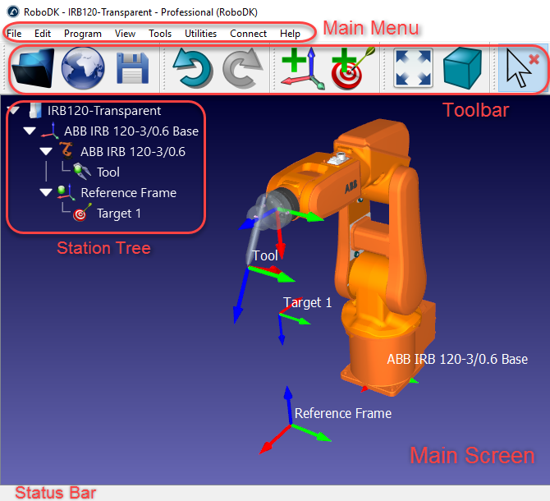
GUI

Slide 4
Navigation on 3D World

Slide 5
Default Commands

Slide 7
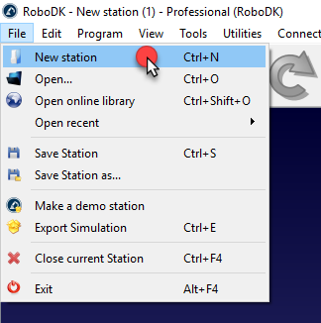
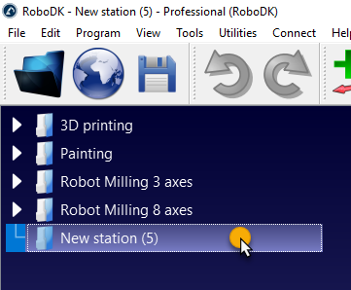
Project
File New Station
Name the project

Slide 8
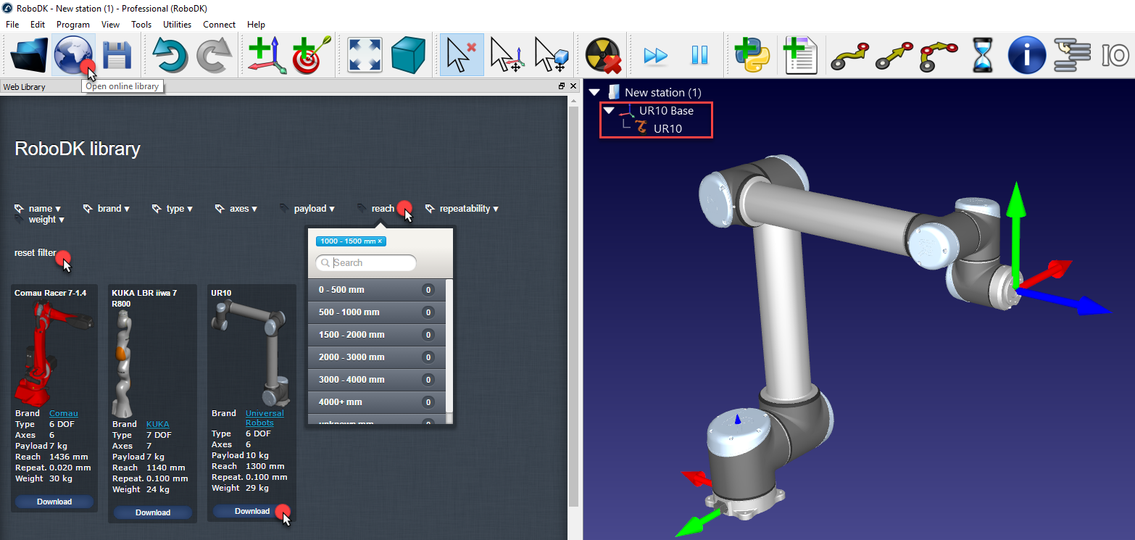
Select Robot
File Open Online Library Select & Download

Slide 9
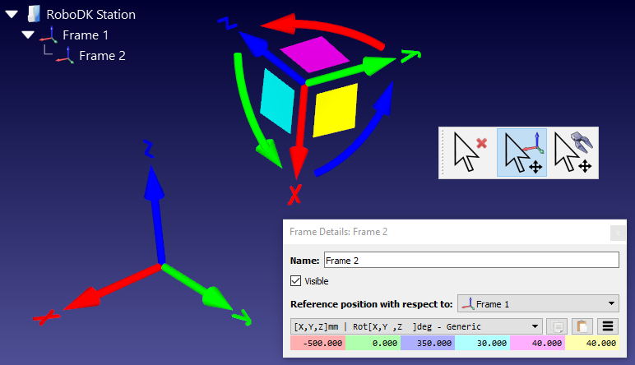
Reference Frame
A Reference Frame defines the location of an item with respect to another item with a given position and orientation. An item can be an object, a robot or another reference frame. All Offline Programming applications require defining a reference frame to locate the object with respect to a robot to update the simulation accordingly.

Slide 10
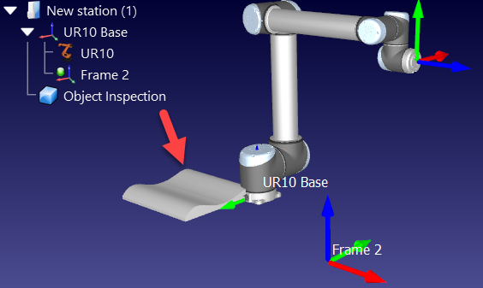
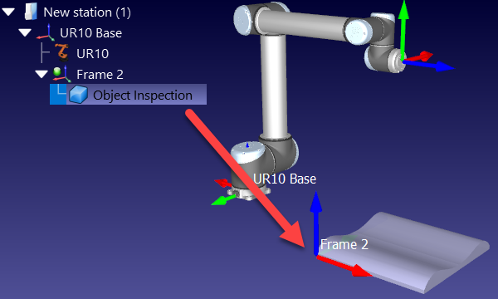
Import 3D objects
RoboDK supports most standard 3D formats such as STL, STEP (or STP) and IGES (or IGS) formats. Other formats such as WRML, 3DS or OBJ are also supported (STEP and IGES are not supported on Mac and Linux versions).

Slide 11
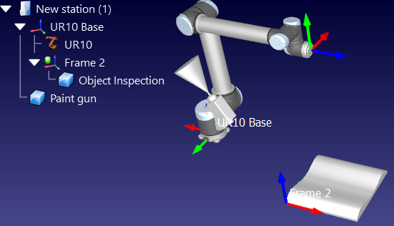
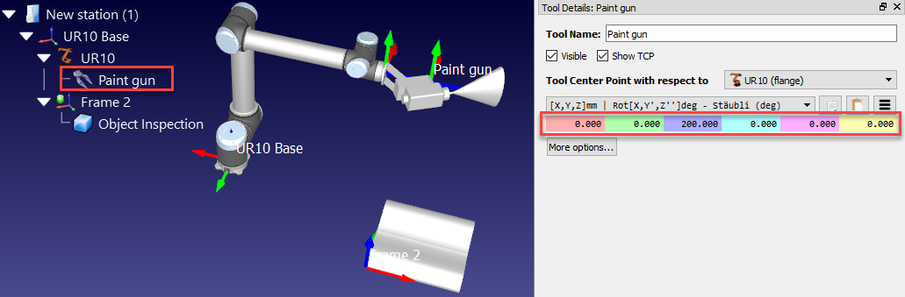
Creating Tool
New robot tools (TCPs) can be loaded or created in RoboDK from previously loaded 3D geometry.
Follow these steps to load an object and set it up as a robot tool:

Slide 12
Create Targets
Robot positions are recorded as Targets. A Cartesian target defines the position of the tool with respect to a coordinate system. A Joint target defines the position of the robot given robot joint values.

Slide 13
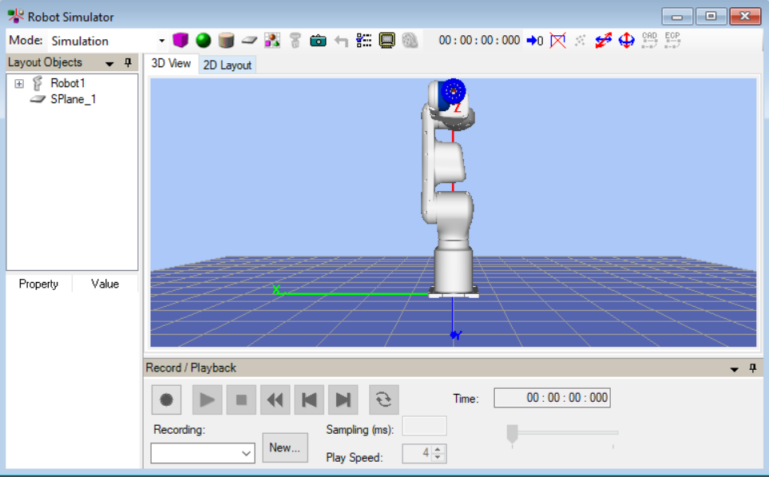
Simulator
On selecting simulator from the toolbar ,simulation environment can be initialized and the child window will be opened.

Slide 14
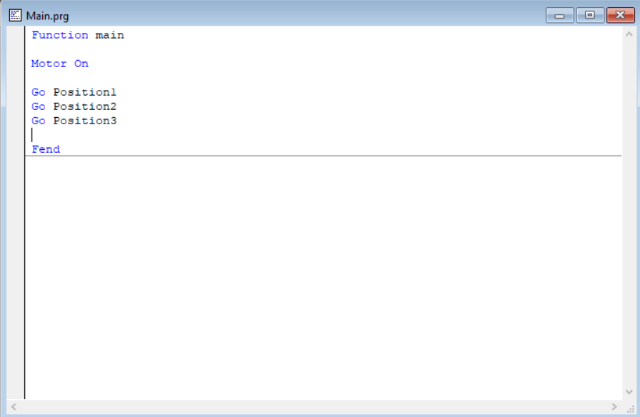
Program Sample
A simple GO program

